Slide 1
Group 19: Everglades Reinforcement Learning AI
GOLD TEAM
Jace Mixon, Bao Hong, Michael Laager, Benjamin Le Heup, Alan Perrow
Speaking: Jace Mixon

Slide 2
Project Overview
Sponsors: Rebecca Broadway, Tanner Lindbloom
Goal:
Create a program that will learn how to play a turn-based strategy game.
And be good at the game!
How to reach the goal:
We created multiple agents using different reinforcement learning techniques.
Speaking: Michael Laager
Notes:
Rebecca helps with understanding the overall goal of the project. Tanner knows more about the specific parts of Everglades and the challenges that reinforcement learning agents have within this environment

Slide 3
Base Requirements
Implement two reinforcement learning agents to play the Everglades AI Wargame.
Agents should consistently achieve greater than a 60% win-rate against an agent with a random action selection strategy.
Agents should demonstrate a consistent, noticeable improvements over series of episodes.
Speaking: Michael Laager
Notes:
Michael

Slide 4
Project Goals & Objectives
We would like to have our reinforcement learning agent to win 75% of the time against a random action agent
Win 60% of the time against state-machine agents with discernible strategies
Implement 3 reinforcement learning techniques
Create a reinforcement learning agent model that can perform better than agents from other universities
Speaking: Michael Laager
Notes:
Michael

Slide 5
Team Responsibilities
Jace Mixon: Implemented PPO, Trained PPO
Bao Hong: Implemented Rainbow DQN, Trained Rainbow DQN
Michael Laager: Implemented PER and Renderer, Testing & Debugging
Benjamin Le Heup: Implemented Base DQN, Testing & Debugging
Alan Perrow: Implemented SAC, Managed Newton GPU Cluster, Agent Training
Speaking: Michael Laager

Slide 6
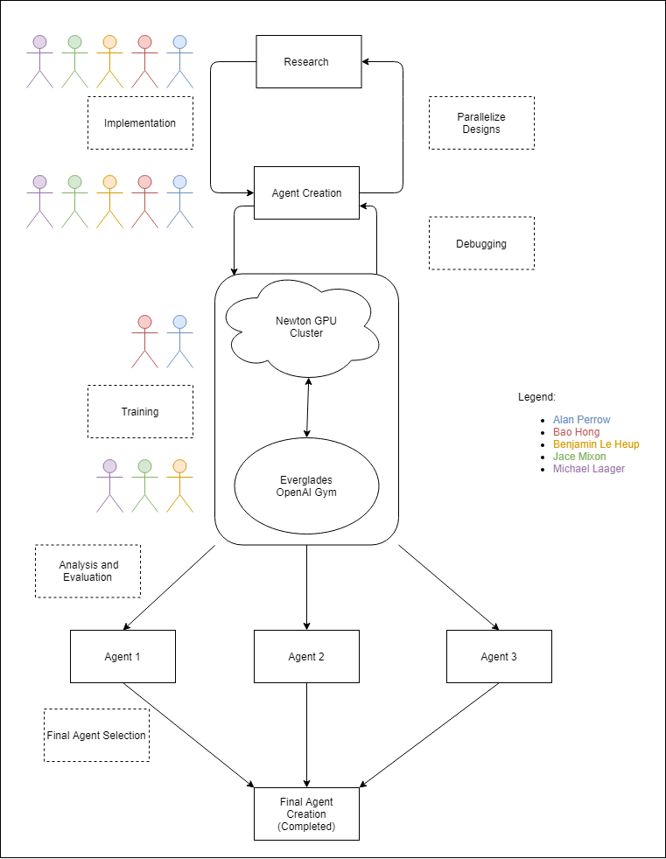
Project Block Diagram
Speaking: Michael Laager

Slide 7
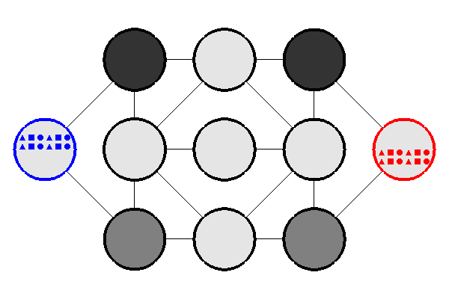
What is Everglades?
Everglades is a 1v1 turn-based strategy game.
For each turn, players move up to 7 of their 12 groups of drones.
Strikers - +50% Movement & Damage; -50% Health
Tanks - +50% Health
Controllers - +50% Capture Speed
Opponent groups battle when not moving inside a node.
Highest score after 150 turns, taking over the enemy base, or destroying all the opponent groups guarantees victory.
Speaking: Michael Laager
Notes:
No battles when bots are in transit
4 groups each
8 bots in each group with one tank groups having 12 bots
Michael

Slide 8
The Opponents (Discernible Strategies)
Same command - Cycles through a set of predetermined actions. Currently, is set to defend nodes adjacent to the base node.
Swarm - Sends two offensive groups of battlebots to attack the opposing base node and leaves one group behind to defend.
Cycle Strategies - Cycles through all groups of battlebots to move them towards enemy base node.
Base rush Strategies - Sends a scouting group of battlebots to the opposing base node and then sends a main group afterwards.
Speaking: Michael Laager

Slide 9
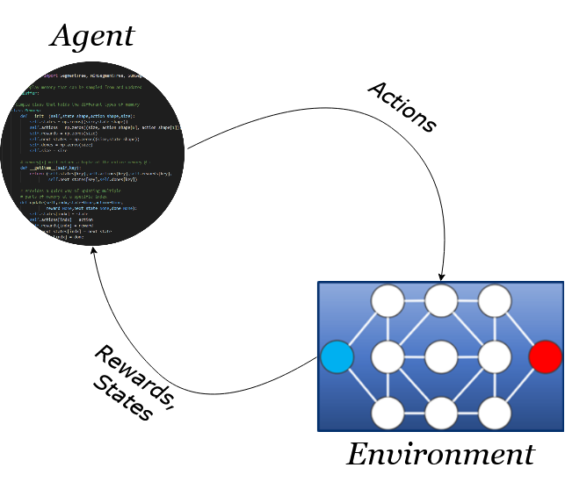
What is Reinforcement Learning?
Goals of Reinforcement Learning:
Barebones - Give the agent minimal information.
Optimal - The agent will find the best way to get the most reward.
How it works:
The agent plays the game many times, exploring the possible actions to get the largest reward.
Speaking: Michael Laager
Notes:
Michael

Slide 10
Environment Rewards and Reward Shaping
Rewards are given at the end of the episode
+1 to an agent indicates the agent’s win in the episode, -1 indicates a defeat, 0 indicates a tie
No rewards are given during any of the timesteps in the episode
Creates Sparse Rewarding Problem
The agent does not know if the action it made was a good choice or not until the end of the episode
Different reward shaping methods:
Score is calculated for each player at each timestep. Make the reward for each timestep be the subtracted difference between the agent’s score and the opponent’s score
Not effective against rushdown opponents that only have low scores at the beginning because they do not control any nodes
For creating defensive behaviors, give a reward for the agent being able to contest nodes closest to its base
Agent will only play defensively if given too many rewards for playing defensively
Speaking: Michael Laager
Notes:
Just added some stuff that I could think of for this slide, needs a peer review so that it’s consistent with the rest of the slides. ~Jace

Slide 11

What is a Neural Network?
At a high level:
A connected network of nodes called neurons
Connections occur between layers of the network
Input layer
Hidden layers
Output layer
The goal of the network is simply to take in input and produce an output
Speaking: Alan Perrow
Notes:
Now that we’ve discussed RL, we can get into something more specific to that area — neural networks.
Explain the basic layout and function
Input - take in input data
Hidden - process input data. Layers ⇔ Complexity
Output - take processed data and output it
(References: Facundo Bre, et. al., “Prediction of wind pressure coefficients on building surfaces using Artificial Neural Networks”, 2017)

Slide 12
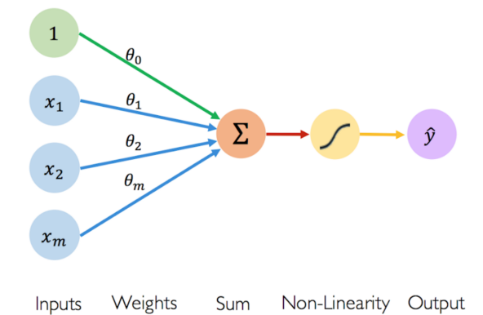
What is a Neural Network?
A more in-depth look:
How a neuron’s output is generated from input values is based on weights, biases, and activation functions
Weights are multiplicative values applied to inputs of a neuron
Biases act as an additional input to a neuron
Activation functions can normalize outputs, act as a threshold, and/or transform output in some other way
A neuron sums all of its weighted inputs, calculates its output value using the activation function, and then sends out that output value
Weights and biases are both learned by training
Speaking: Alan Perrow
Notes:
(Activation functions) For example: sigmoid for single 0-1 prediction, softmax for multi-class prediction
(References: MIT Alexander Amini, 2018 introtodeeplearning.com)

Slide 13
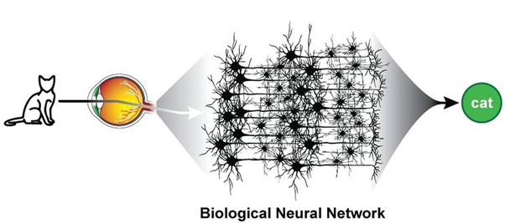
What does it mean to learn?
A neural network’s structure is similar to our current understanding of the human brain
In reinforcement learning, we start with a simple goal and strive to achieve it with minimal input
The network attempts to learn an optimal method of obtaining maximum rewards from a given environment
We call this process training
Weights and biases are each set to some initial value
Throughout training, these values are adjusted to try to produce better results
How this happens depends on the complete implementation of the network, also known as the model
Speaking: Alan Perrow
Notes:
Explain how artificial neural networks are overly simplified versions of current models of biological neural networks
The way our brains and RL work both share a common goal — to obtain info / derive meaning with minimal input
NN experiences the environment and tries to discover ways to maximize its rewards and even avoid penalties
The NN “learns” from this and attempts to adjust its model via weights and biases
This is known as training
So how do we train our models?

Slide 14

Newton GPU Cluster
Training a model takes a large amount of time and computation power
Training a model well takes even more of both
Instead of training locally, we have access to a better resource: Newton GPU Cluster
Courtesy of the ARCC (UCF’s Advanced Research Computing Center)
Job-based system where users request resources
Significant learning curve
Is it worth it?
Speaking: Alan Perrow
Notes:
The answer is: with lots of computation. [read bullets]
Dr. Heinrich provided us with student access to the ARCC @ UCF.

Slide 15

Newton GPU Cluster
YES!
Allotted 10,000 CPU hours and 2,000 GPU hours per month
Parallelizable
State-of-the-art hardware
For comparison’s sake
Local training (NVIDIA GTX1060 6GB):
55 minutes for 200 episodes
Training on Newton (20x Dual PCIe NVIDIA Tesla V100 16/32GB):
9 minutes for 200 episodes
> 6x faster!
Speaking: Alan Perrow
Notes:
Ten nodes each with dual NVIDIA Tesla V100 16GB PCIe GPUs (go look that up if you want!) Ten nodes each with dual NVIDIA Tesla V100 32GB PCIe GPUs Interactive visualization node with triple NVIDIA GTX980 GPUs driving 80-inch 3-D display 100Gb EDR InfiniBand interconnect
In addition, the UCF ARCC also provides: 240TB of configured storage 20Gb connection to UCF campus core network 250kW power with an uninterruptible power supply and generator 100 tons of dedicated cooling

Slide 16
Deep Q-Network (DQN)
What is Q-Learning? Example:
However, this doesn’t work well with the large state-action game environment of Everglades.
DQN comes in as the solution to this problem:
Instead of using a table, it uses a neural network to approximate the Q-value of a [state, action] pair
Training the DQN network allows for more accurate Q-value estimations, which improves the agent’s performance
Start
-1 | 0 | 23 | 4
0 | 0 | 0 | 1
0 | -4 | 2 | 0
1 | 0 | 5 | 1
8 | 1 | -3 | 0
Nothing
Power
Mines
End
Speaking: Alan Perrow
Notes:
So, this is all useful info, but how is it relevant? How does Everglades use Neural Networks? For each agent, we must create a unique model to be trained through reinforcement learning. Let’s discuss our first agent. As a background, it is based on the concept of Q-Learning:
An off-policy RL algorithm that seeks to find the best action to take, given the current state
Stores the expected Q-values inside a Q-table with a dimension of [states, actions]
An agent chooses an action by either:
Exploitation: selecting the [state, action] pair that has the highest Q-value in the table, or
Exploration: Act randomly
However, for large state-action environment like Everglades, it’s infeasible to create a Q-table to hold all states and actions of the game
At end of slide, mention D3QN — how we started adding more “layers” on top of the basic DQN
Hand off to Bao

Slide 17
Rainbow DQN
A group of algorithms that complement the base DQN by improving upon different limitations
Our final Rainbow DQN is actually a half Rainbow with these extensions:
Base DQN
Double DQN
Dueling DQN
Prioritized Experience Replay
Speaking: Bao Hong

Slide 18
Choosing actions
12 groups x 11 nodes = 132 possible actions at any given turn
Naive solution: run the DQN to produce a table size of 132 then chose the max 7 q values as our actions for the turn.
Final solution: After run the DQN and get the Q table (size 132), simply reshape the table into a 12x11 shape. Choose the max LEGAL Q value for each of the 12 rows, then chose the max 7 of them. In case where no LEGAL move is found in a row, we simply replace it with a 0 value and represent the action as [0,0] which is not a legal move and doesn’t have any effect on the environment.
Speaking: Bao Hong

Slide 19
Training and Testing Process
The main focus was getting a good result against random agent first. Most of the time was spent on training, testing, and finding best possible model against random agent.
We use win rates to measure success for each extension.
For training data, we use win rates of the last 100 games as the benchmark. We save the model at the peak win rate for each training session and then test it.
Speaking: Bao Hong

Slide 20
Training and Testing Process (cont)
For testing data, we run the saved model for 500 games and pick the win rate at the end, as win rate should already have converged at this point during testing.
If testing data has a high win rate (>90%), then we decide the model doesn’t need further training.
For training against discernable agents, we chose the best model against random agent and train with low exploration rate against each of the given discernible agent so that we don’t compromise with the win rate against random agents too much.
We also terminate the training session early if we get a good result (peak found). In most cases, it happens anywhere from 5000 games to 20000 games, so some of the graphs for training data may have different amounts of training episodes.
Speaking: Bao Hong

Slide 21
Hyperparameters
 | Base DQN | Double DQN | Dueling DQN | PER DQN
Min Epsilon | 0.01 | 0.01 | 0.01 | 0.01
Gamma | 0.95 | 0.95 | 0.95 | 0.95
Speaking: Bao Hong

Slide 22
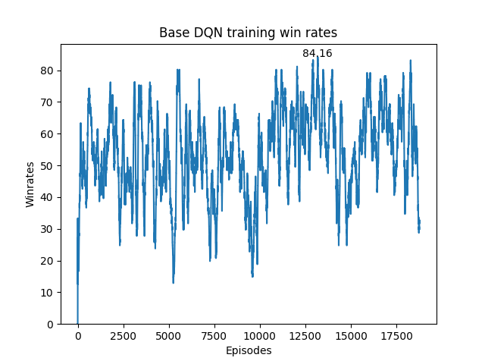
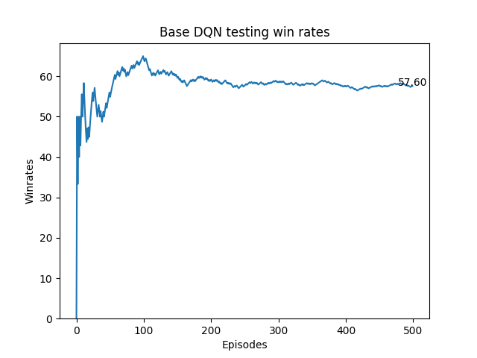
Base DQN
Speaking: Bao Hong

Slide 23
Double DQN
Base DQN use a single neural net to approximate current Q value of an action and the target Q value at the same time, which causes the model to overestimate bias and leads to unstable training.
Double DQN uses 2 networks: a policy network for estimating current Q, and a target network that is updated periodically to estimate target Q.
Speaking: Bao Hong

Slide 24
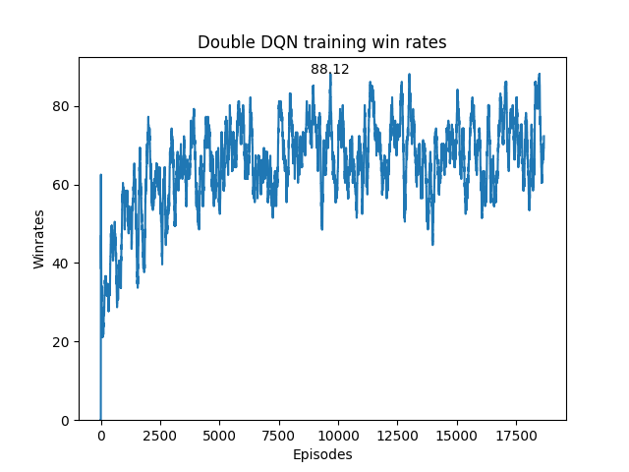
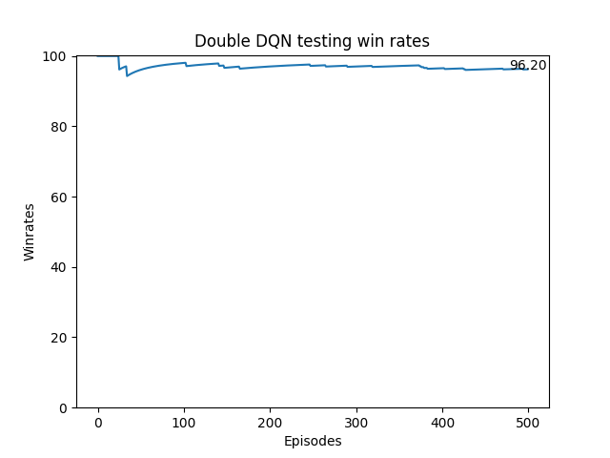
Double DQN
Speaking: Bao Hong

Slide 25
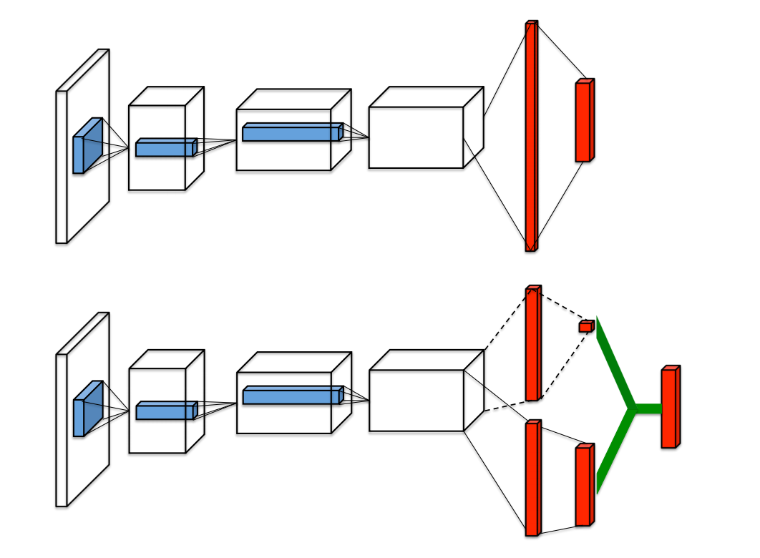
Dueling DQN
Split the DQN network into a value network and advantage network.
Value network estimates the value of a given state.
Advantage network estimates what action is more favorable to take at a given state
DQN
Dueling DQN
Speaking: Bao Hong

Slide 26
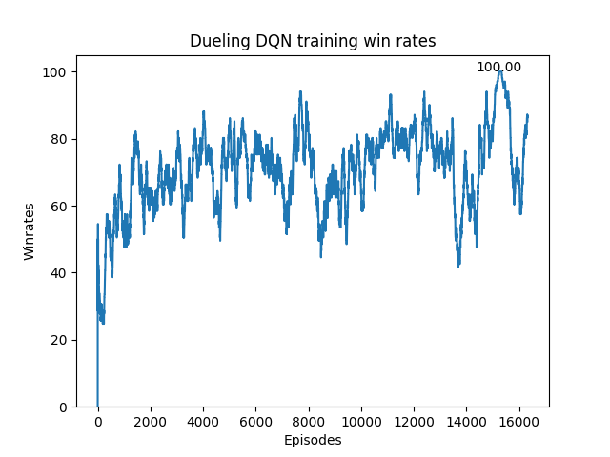
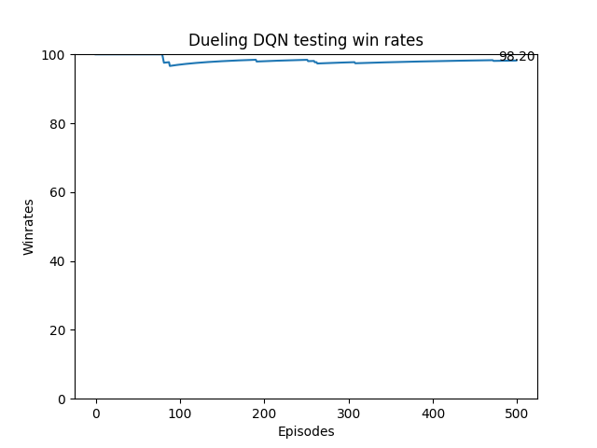
Dueling DQN
Speaking: Bao Hong

Slide 27
Prioritized Experience Replay
In base DQN, game states are stored in a memory buffer, then are sampled randomly to train the model
Instead of random sampling, PER assigns each game state in memory a probability of getting selected by the model, which increases the chance for good states to be learned
Speaking: Bao Hong

Slide 28
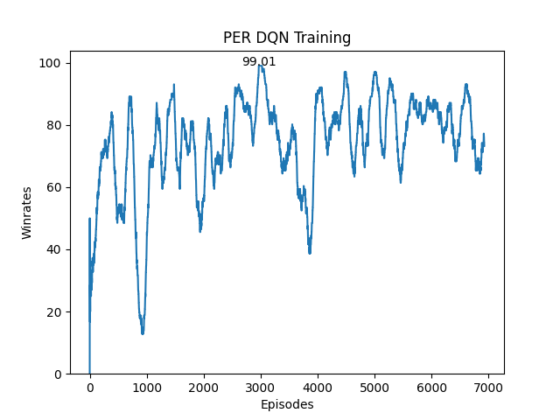
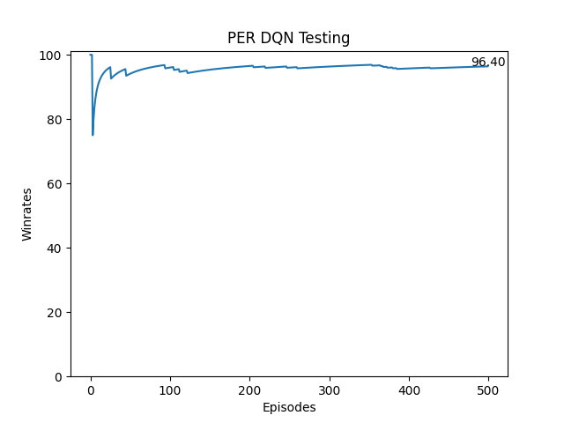
Prioritized Experience Replay
Speaking: Bao Hong

Slide 29
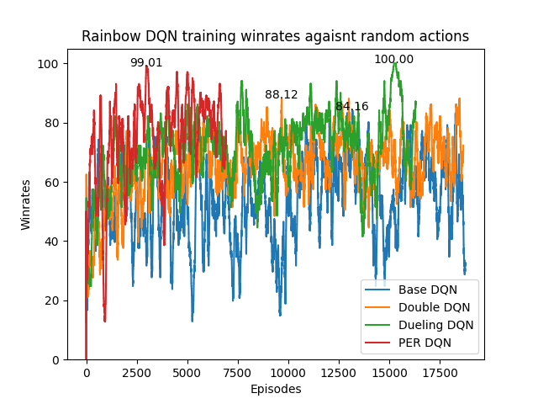
DQN Training Data
Rainbow DQN training winrates against random actions
Training data max win rates:
Base DQN: 84.16%
Double DQN: 88.12%
Dueling DQN: 100%
PER DQN: 99.01%
Speaking: Bao Hong

Slide 30
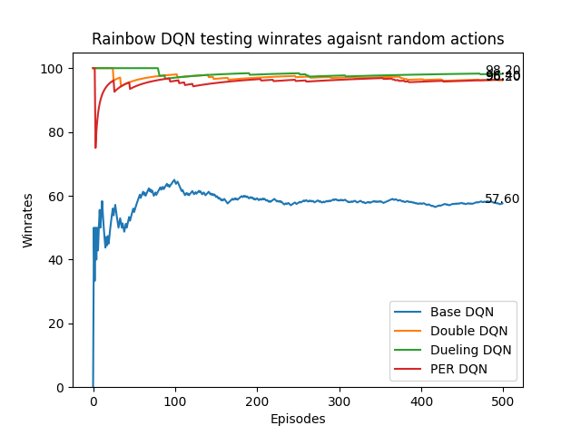
DQN Testing data
Rainbow DQN training winrates against random actions
Training data max win rates against random actions:
Base DQN: 57.60%
Double DQN: 96.20%
Dueling DQN: 98.20%
PER DQN: 96.40%
Speaking: Bao Hong

Slide 31
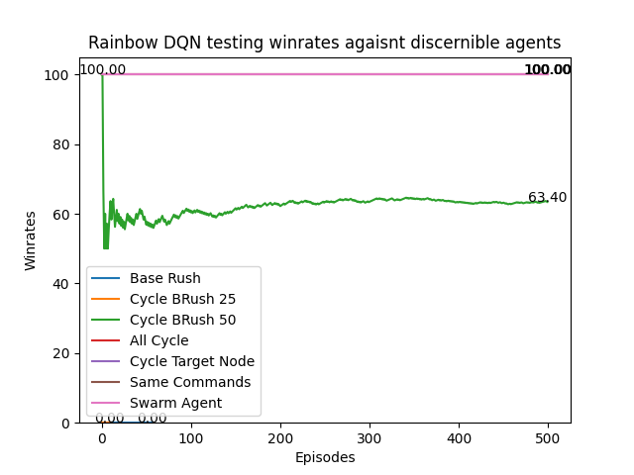
Discernible Strategies
Rainbow DQN training winrates against random actions
Base Rush and Cycle BRush 25: 0%
Cycle BRush 50: 63.40%
All Cycle, Cycle Target Node, Swarm Agent, Same Commands: 100%
Speaking: Bao Hong

Slide 32
Why not full rainbow?
Short answer: we tried.
Long answer:
We’re satisfied with the win rates we got from training previous DQN version.
We did experiment with other DQN extension such as Noisy Net and Multi-Step Learning but found worse results.
Final decision: we will stick with the first 4 DQN modifications.
Speaking: Bao Hong

Slide 33
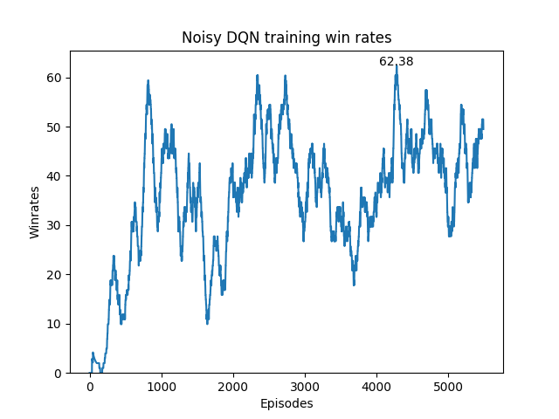
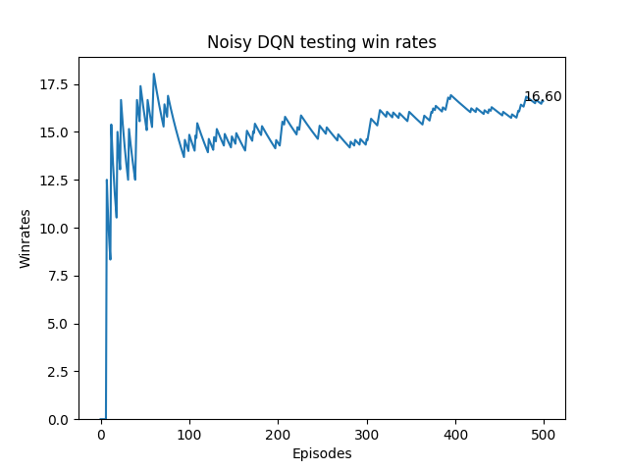
Noisy Net DQN
Speaking: Bao Hong

Slide 34
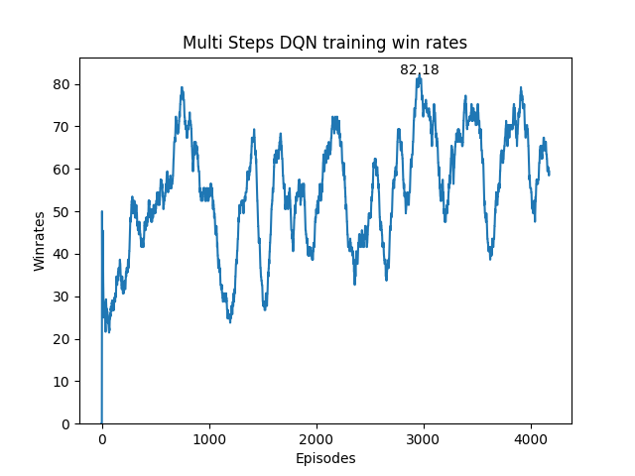
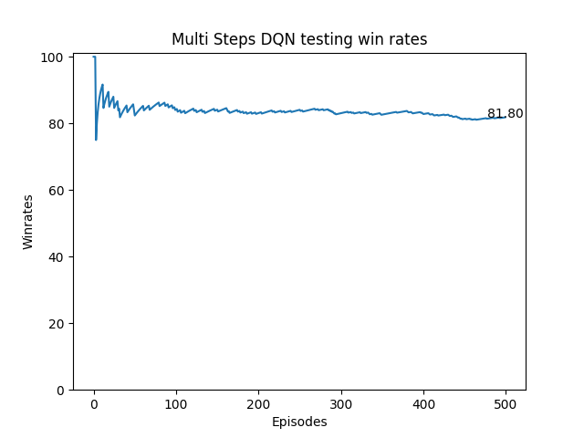
Multi-Steps Learning
Speaking: Bao Hong

Slide 35
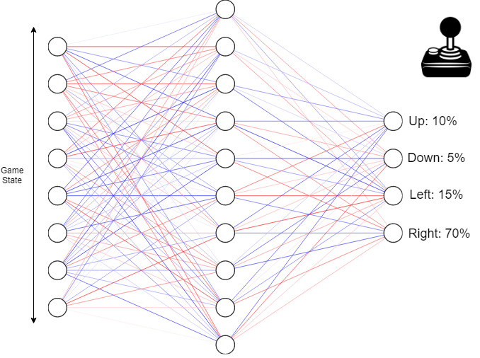
Proximal Policy Optimization (PPO)
On-policy algorithm that computes probability distribution across all available actions
Goals of algorithm:
Maximize potential rewards by calculating probabilities towards the most rewards
Reduce drastic changes to network’s prediction policy by applying a clipping boundary
Three versions of algorithm:
Base PPO
PPO + Epsilon
PPO + Intrinsic Curiosity Module
Assistance from legal move masking
Speaking: Jace Mixon
Notes:
Jace

Slide 36
PPO Training Algorithm (Part 1)
Opponent Selection:
All discernible agents played against each other for 10 games per match. Each victory for an agent increased the agent’s “difficulty” rating
Create a roster of discernible agents sorted by difficulty for the AI agent to train against
“Cumulative Learning”
Final roster of opponents (top-of-list = least difficult, bottom-of-list = most difficult):
random_actions*
Same_commands
Swarm_agent
All_Cycle
Cycle_Rush (25/50)
Base_RushV1
Cycle_Target_Node11
*- random_actions is inserted so that PPO can have training/testing results against random_actions opponent
Speaking: Jace Mixon

Slide 37
PPO Training Algorithm (Part 2)
Cumulative Training:
Start with the least-difficult opponent and work up to more difficult opponents
For each opponent:
Train for 20,000 episodes and randomly select the current opponent or a previous opponent per episode, with the probabilities skewed towards the current opponent
For every 5,000 episodes:
Test the agent for 1,000 episodes to get the winrate percentage
If the winrate > 75%
End training for current opponent
After each opponent:
Update probability skew for next opponent
Speaking: Jace Mixon

Slide 38
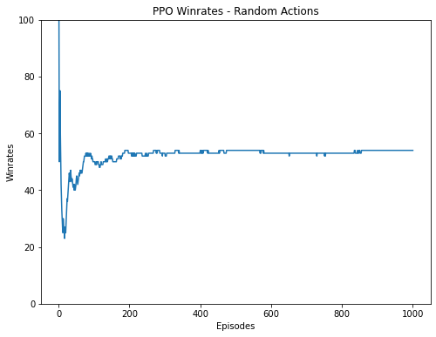
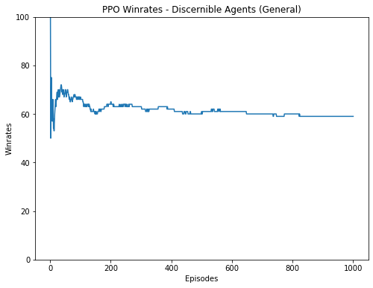
PPO Testing Data
Speaking: Jace Mixon

Slide 39
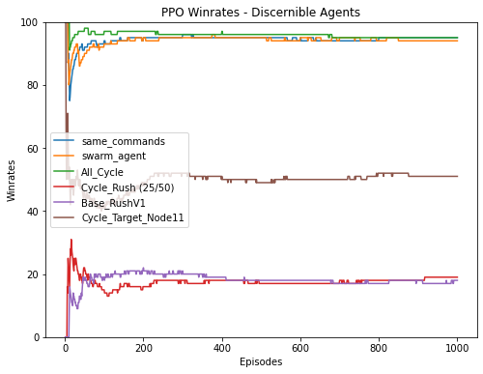
PPO Testing Data
Winrates:
same_commands: 95%
swarm_agent: 94%
All_Cycle: 95%
Cycle_Rush (25/50): 20%
Base_RushV1: 18%
Cycle_Target_Node11: 51%
Speaking: Jace Mixon

Slide 40
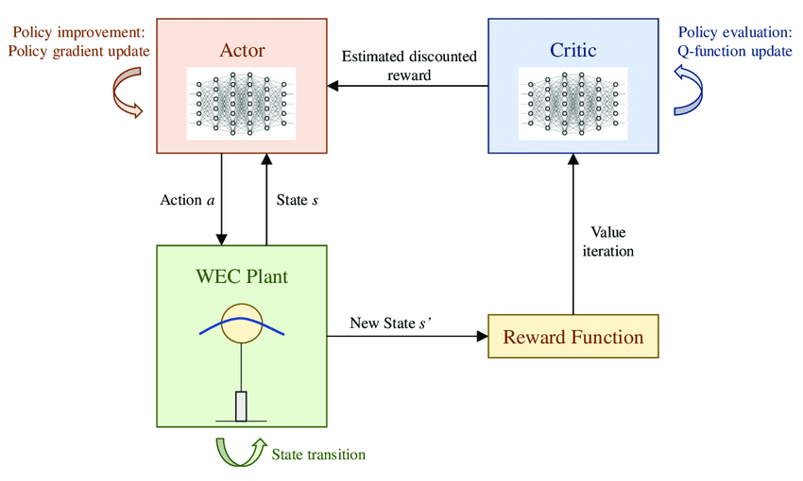
SAC (Soft Actor-Critic)
Key features:
Off-policy algorithm
Learns optimal policy values independently of the agent's actions
Maximizes both reward and entropy
Allows for large amounts of environment exploration
Makes use of a double Q-network
Has one issue:
Originally designed for continuous environments
There are mentions in published research papers about how to go about discretizing the algorithm, so we used those resources to create our own Discrete SAC agent.
Everglades
Speaking: Alan Perrow
Notes:
Issue is common among policy gradient algorithms (continuous is more beneficial I guess)
Reference: https://www.researchgate.net/figure/Diagram-of-the-soft-actor-critic-SAC-algorithm-for-the-real-time-control-of-a-wave_fig3_344992071
Anderlini, Enrico & Parker, Gordon & Abusara, Mohammad & Thomas, Giles. (2020). Towards Real-Time Reinforcement Learning Control of a Wave Energy Converter. Journal of Marine Science and Technology. 8. 845. 10.3390/jmse8110845.

Slide 41
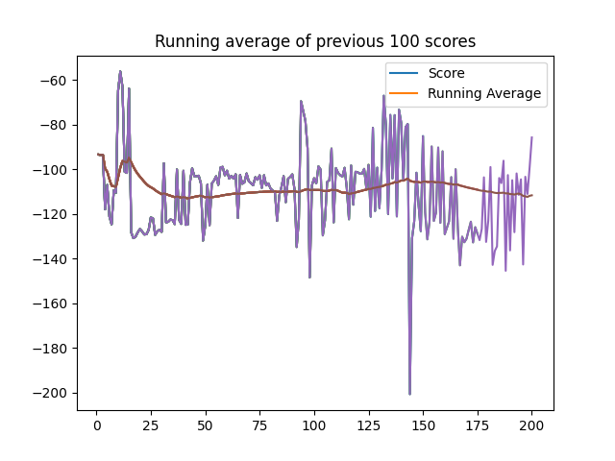
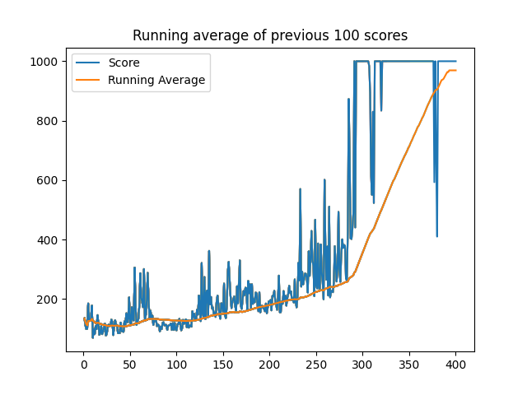
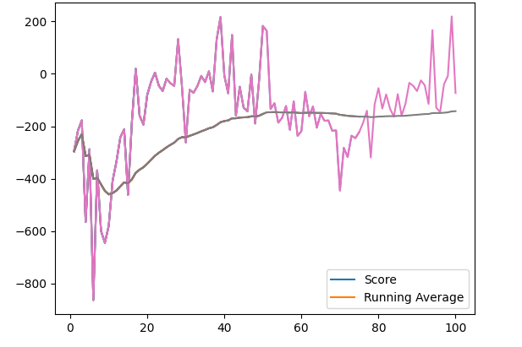
Original SAC Performance on Other Environments
Before translating our continuous SAC agent to a discrete setting, we evaluated the performance on some continuous environments frequently used as benchmarks:
BipedalWalker-v3
InvertedPendulum-v1
LunarLanderContinuous-v2
Speaking: Alan Perrow
Notes:
We did this to make sure after translating our continuous SAC model to a discrete SAC model, we didn’t mess anything up along the way

Slide 42
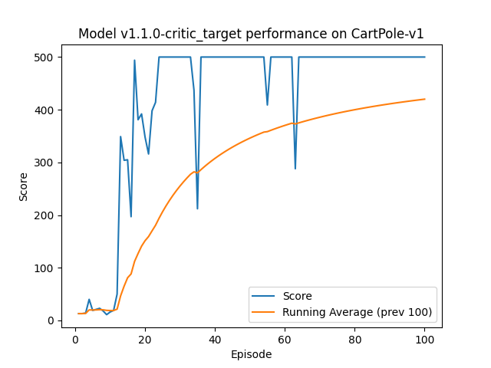
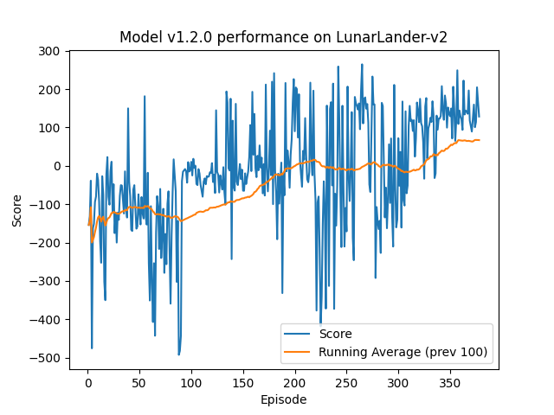
Discrete SAC Performance on Other Environments
After translating our SAC agent to a discrete setting, we again evaluated the performance, but this time on discrete versions of the environments used for the previous benchmarks:
CartPole-v1
LunarLander-v2
Speaking: Alan Perrow
Notes:
Notice the erratic behavior: this is due to the reward-entropy maximization inherent in SAC

Slide 43
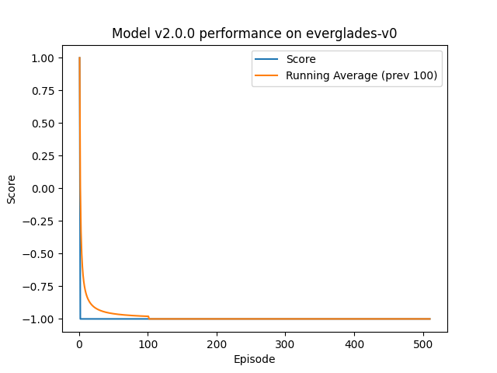
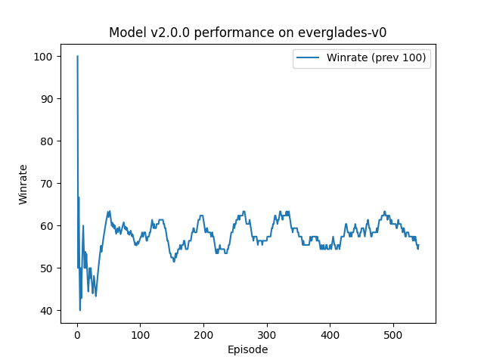
Discrete SAC Performance on Everglades
First failed run:
Our discrete agent did not have enough training time to fully converge to good results on Everglades
The discrete version of this agent is very sensitive to entropy optimization and hyperparameter tuning
With a legal move mask and PER sampling implemented, this agent should theoretically perform at least as good as Double DQN
Best run: Temperature = 0.8 Target Entropy = 0.98ln(7)
Speaking: Alan Perrow
Notes:
Time constraints:
Newton GPU hours limit reached
Hard to translate simple discrete env.s => everglades [ 7 x (11,12) ] space

Slide 44
Challenges
Unorthodox game environment (make 7 choices per turn)
Improve win rates against some discernible strategies, especially early rushes
Analyzing complex research papers
Testing hyper-parameter tunings is computationally expensive
Sparse reward of the environment
Training sessions can take between 4 hours to 72 hours at a time, making the debugging process tedious and slow
Managing Newton cluster resources
Speaking: Benjamin Le Heup
Notes:
4-8 hours a sessions currently
Training session times depends on training complexity (the more complex, the more time it takes)

Slide 45
Environment challenges
The environment rewards players for being very aggressive:
The environment does not give a opposing player any indication of where a group of bots is going when they are in transit
The base node does not have a defense bonus multiplier
Bot groups can pass enemy bot groups freely in this environment
Observation space uses integers to represent categorical data
Environment does not have a renderer to show what is the current game state
Speaking: Benjamin Le Heup

Slide 46
Successes
Implemented and trained 5 out of 6 extensions of Rainbow DQN
Rainbow DQN extensions are completely modular
Implemented and trained PPO
Implemented and trained SAC
Created various reward shaping methods
Created a Renderer for the Everglades environment
One-Hot Encoded the environment’s observation space
DQN and PPO agents are able to beat discernible agents more than 60% of the time on average
Speaking: Benjamin Le Heup
Notes:
ben

Slide 47
Timeline
Research
Built an understanding of Reinforcement Learning
Learned how to use Tensorflow/Pytorch
Researched the Everglades environment
Testing and Debugging DQN
Tested for optimal hyperparameters
Discovered limitations of DQN
Implementing Half-Rainbow
Implemented Double, Dueling, PER and Noisy Net parts of the agent
Implemented action masking method
November 2020
January 2021
October 2020
December 2020
February 1st-February 15th 2021
Implemented DQN
Designed output layer for everglades environment
Created methods of how to choose actions in Everglades environment
Got access to Newton GPU cluster
Implemented PPO
Completed first version of PPO
Started using Newton GPU Cluster for long training sessions
Began testing and debugging PPO
Implemented ICM for PPO
Speaking: Benjamin Le Heup
Notes:
A lot of the first semester was spent doing research
We were navigating through complicated research papers

Slide 48
Timeline
Optimizing Algorithms
Added Multi-step part of DQN
Optimized PPO to perform better
One-hot encoded the observation space
Discernible Strategy Training and Testing
Trained PPO to beat Base rush and still have the agent remember to accumulate points
Averaged over 60% win rate among discernible agents
March 1st - March 15th 2021
April 2021
February 16th-February 28th 2021
March 16th - March 31st 2021
Reward Shaping
For capturing as many nodes and getting a high score
For defending nodes close to the base nodes
Finalizing Agents and Documentation
Created SAC agent
Collected data for the final documentation
Speaking: Benjamin Le Heup
Notes:
A lot of the first semester was spent doing research
We were navigating through complicated research papers

Slide 49
What we have learned?
Analyze and apply information in complex research papers on machine learning
How to use machine learning frameworks like pytorch and tensorflow
Deep understanding in some of the most popular and complex RL models (DQN, PPO, SAC).
How to analyze a reinforcement learning environment and create reward shaping methods to help a neural network to converge to a desired model
How to analyze testing data and rigorously assess how our agent performs against multiple discernible strategies
Speaking: Benjamin Le Heup

Slide 50
Budget
$0
Thanks to UCF Newton Cluster, we can have access to free gpu training without renting other paid alternatives for VMs such as Amazon, Azure, or Paperspace.
Limit: 10000 hours of CPU, 2000 hours of GPU per month
Without Newton:
Use our own GPU: Overheat, electric cost, turtle performance.
Rent other paid service: to rent a VM that could achieve similar performance to Newton, it potentially could cost hundreds to thousands of dollar each month
Speaking: Benjamin Le Heup

Slide 51
Questions?

Slide 52
Demo Slides

Slide 53
The Renderer
Group Types
Strikers:
Controllers:
Tanks:
First State
In Transit:
Dead:
Node Types
Fortresses:
Watch Towers:
Speaking: Michael Laager

Slide 54
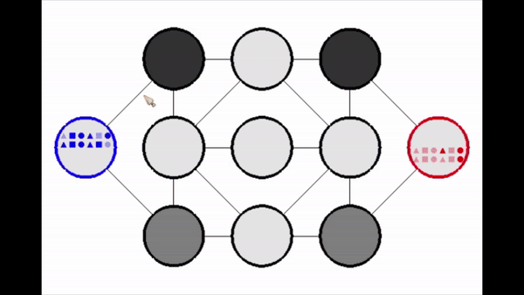
DQN Performance
Random actions
Win rate: 96.40%
DQN Agent Random Action
Speaking: Bao Hong

Slide 55
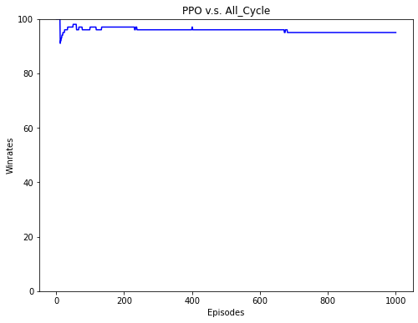

PPO Performance
PPO Agent All_Cycles
Speaking: Jace Mixon

Slide 56

SAC Performance
Discrete SAC Agent Random Action
Speaking: Alan Perrow

Slide 57


Thank you!
Senior Design Coordinators
Dr. Mark Heinrich
Dr. Richard Leinecker
Committee Members
Prof. Sarah Angell
Dr. Christopher Hollander
Dr. Mark Llewellyn
Lockheed Martin Sponsors
Rebecca Broadway
Tanner Lindbloom

